Slide 1
Hamiltonian Graph and Circuit

Slide 2
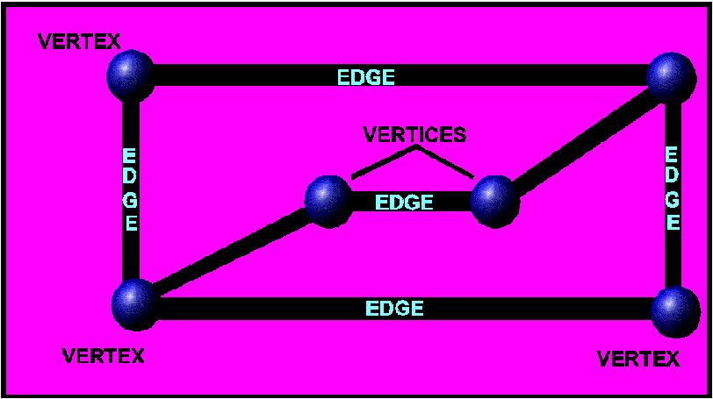
Vertex Edge Graph - A collection of points some of which are joined by line segments or curves.
This graph has 6 vertices and 7 edges
Each point is a vertex and each line is an edge

Slide 3
Degrees of a vertex
The degree of a vertex in a graph is the number of edges that touch it.
2
3
Each vertex is labeled with its degree
4
3
3
2
3
A graph is regular if every vertex has the same degree.
2
2
2

Slide 4
Vocabulary:
Hamiltonian Circuit/Paths:
A Hamiltonian path in a graph is a path that passes through every vertex in the graph exactly once. A Hamiltonian path does not necessarily pass through all the edges of the graph, however.
A Hamiltonian path which ends in the same place in which it began is called a Hamiltonian circuit.

Slide 5
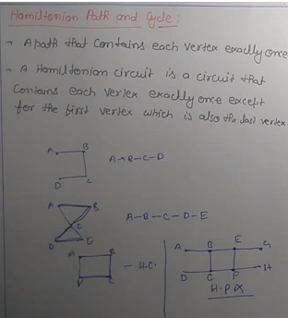

Slide 6
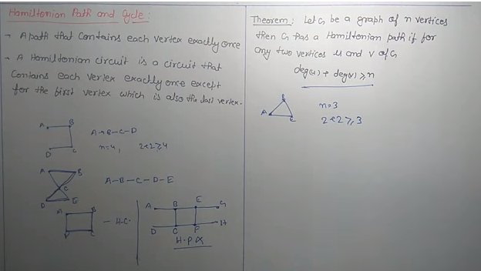

Slide 7

Trace a Hamiltonian path
Only a path, not a circuit. The path did not end at the same vertex it started.
The path does not need to go over every edge but it can only go over an edge once and must pass through every vertex exactly once.
Hamiltonian Circuits are often called the mail man circuit because the mailman goes to every mailbox but does not need to go over every street.

Slide 8
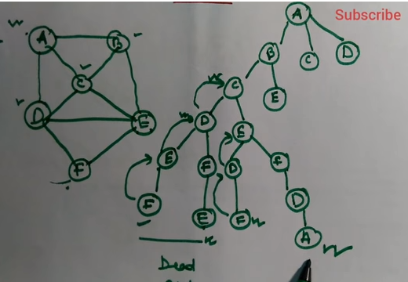

Slide 9
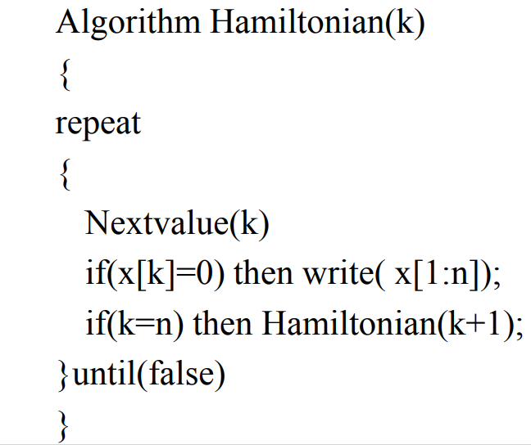

Slide 10
